Slide 1


ME 3D Printer
Making the novel of 3D printing accessible for all.
Samantha Eligene, seligene@bu.edu
Sara Hamdy, shamdy@bu.edu
Brandon Ziolkowski, brandonz@bu.edu
Paolo Casas, jpcasas@bu.edu

Slide 2
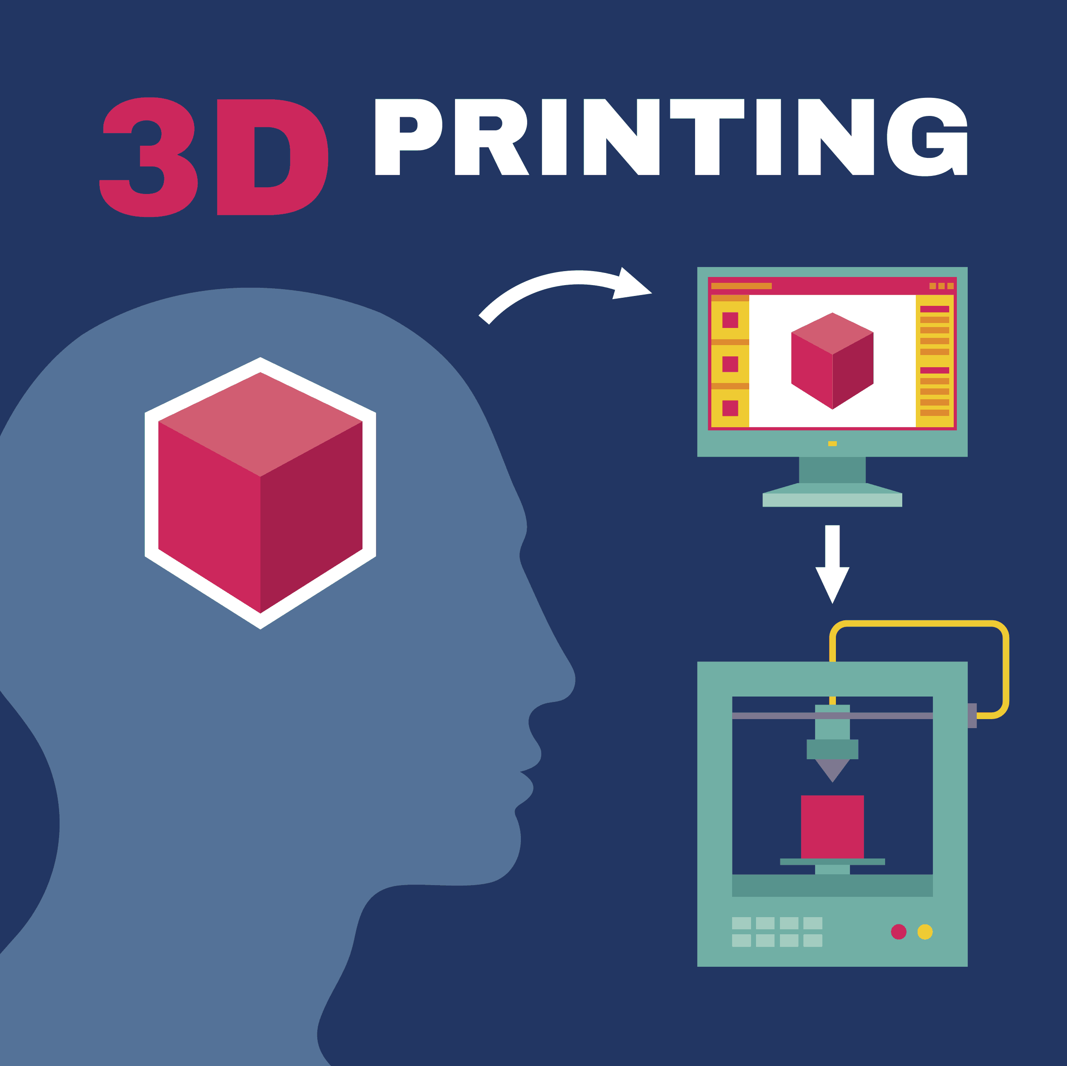




Company Overview
ME 3D is a 3D printing company aimed at bridging the skills gap between general public and 3D printing
Affordable, intuitive app interface, preloaded and expanding CAD catalog
Our Team:
Samantha Eligene
Chief Executive Officer
Master’s in Biomedical Engineering
Paolo Casas
Chief Financial Officer
MBA in Accounting
Brandon Ziolkowski
Chief Strategy Officer
MBA in Strategy
Sara Hamdy
Chief Marketing Officer
MBA in Marketing

Slide 3


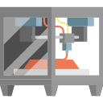
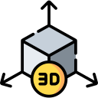


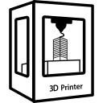
Problem Statement
Majority of people do not have necessary background knowledge to create CAD models themselves
Typically only “engineers” receive formal CAD instruction → engineers make up roughly 5% of college graduates
Current Process:
Proposal:
ME 3D
Notes:
https://www.cnbc.com/2017/12/15/the-6-most-popular-college-majors.html
Recognize that you can just go search for the files online but you often have to pay to download the file and it might not be intuitive to find what you’re looking for

Slide 4





Market Size
Global 3D printing market valued at 9.9 billion USD (2018)
Value mostly held by industrial and manufacturing applications
People open to buying a desktop 3D printer: 6% of general 3D printing market
600K consumer printers sold in US (2018)
Key Market Segments
DIYers
Hobbyists
Craftsmens
Elderly
Educators
Tech enthusiasts ranging from 20s-40s
“Projected to be valued at 34B by 2024”
Notes:
https://www.marketsandmarkets.com/Market-Reports/3d-printing-market-1276.html

Slide 5




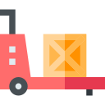
Solution Statement
Main components to the ME 3D printer:
Companion app for accessibility and usability
Pre-installed and expanding CAD catalog
On-demand consulting team ready to tailor existing CAD model
App scanning feature for printing of live scans
Optional Filament Refill Subscription Service

Slide 6







Secret Sauce
Large education gap in 3D printing technology works to our advantage
Few printers on the market that support printer and smartphone pairing to choose an item and have it printed all from the app
Offers a streamlined service for both experienced users as well as those new to the technology
ME 3D

Slide 7
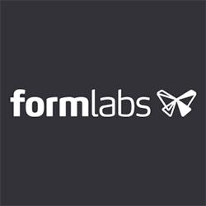
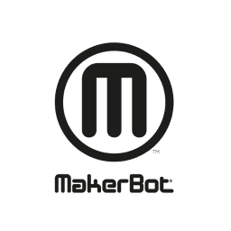



Competition
Preloaded CAD models
WiFi Connected App
Image Scan and Print
Resin Subscription
CAD Model Consultation
Notes:
We recognize that other companies can easily go and implement the same concept that we are pursuing, but our focus is on convenience for our customers not protecting the actual CAD models.

Slide 8









Sales and Marketing
Showcase at tech conferences
Magazine ads to target elderly
Match customer demand through website salesfor 2nd and 3rd years
Heavy allocation of funds towards marketing 1st year and holiday season
Launch filament refill subscription service 2nd year
Limited quantity sold 2nd 6 months, build up production capacity
Expand sales to be sold at brick and mortar retailers and other online platforms
Distribute free product for promotion 1st 6 months

Slide 9

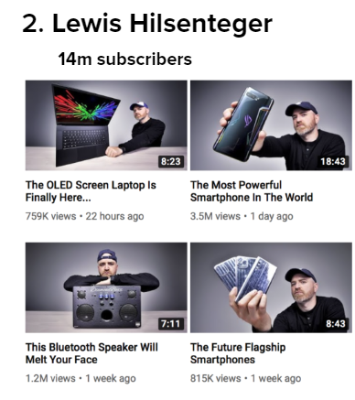



Partnerships and Collaborations
Primary partnership:
Filament supplying companies such as IC3D or Matterhackers
Initial startup investors
Tech Influencers
Social Media Companies
Further Partnerships:
Online retailers such as amazon
Brick and mortar tech retailers such as Best Buy or Staples
Notes:
Retail cost for ABS filament $17/kg → buy in bulk for $15/kg

Slide 10
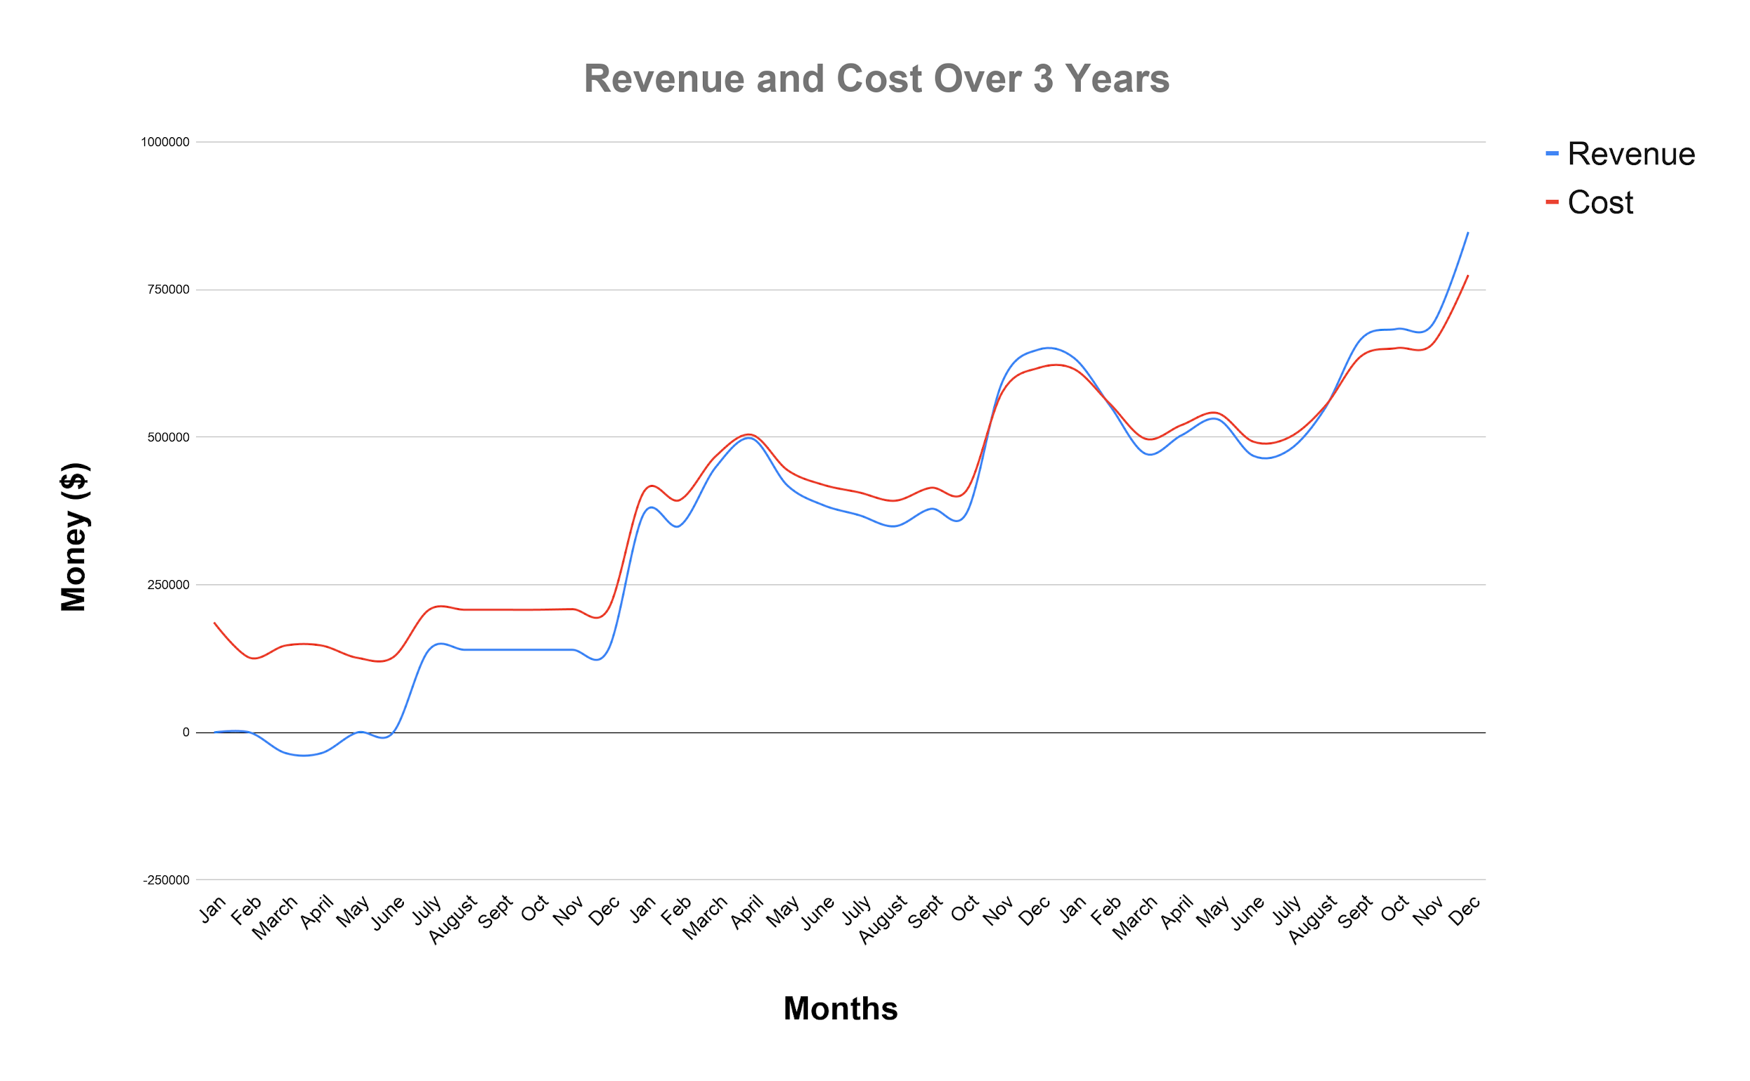
Milestones
Break even Temporarily
Expand to physical stores
Limited Product Released
Break even
Subscription Launch and Website Sales
Promotional Period

Slide 11
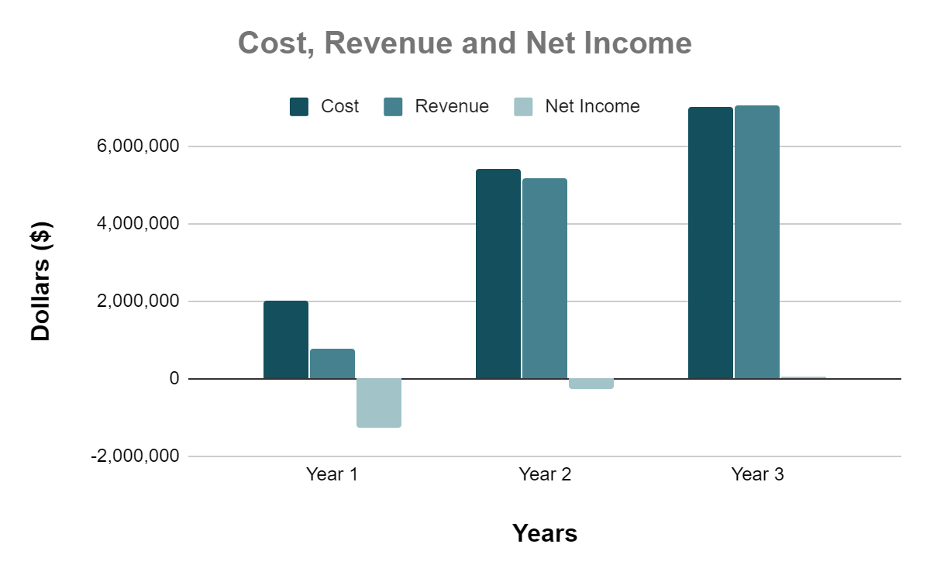
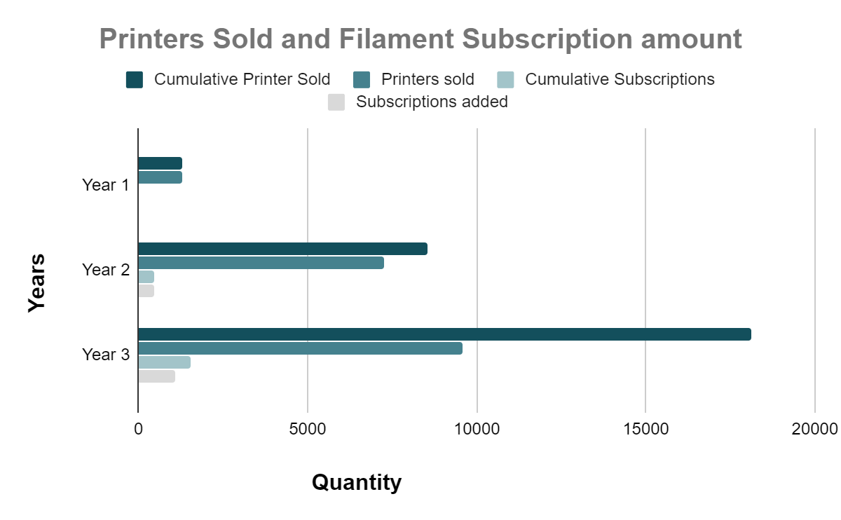
Financials
Key Metrics
Printer Production - $400
Price Point - $700
Filament Cost - $15 in bulk
Monthly Subscription - $25
Based in Kansas for low rent
Year 3 Employee Count: 13

Slide 12
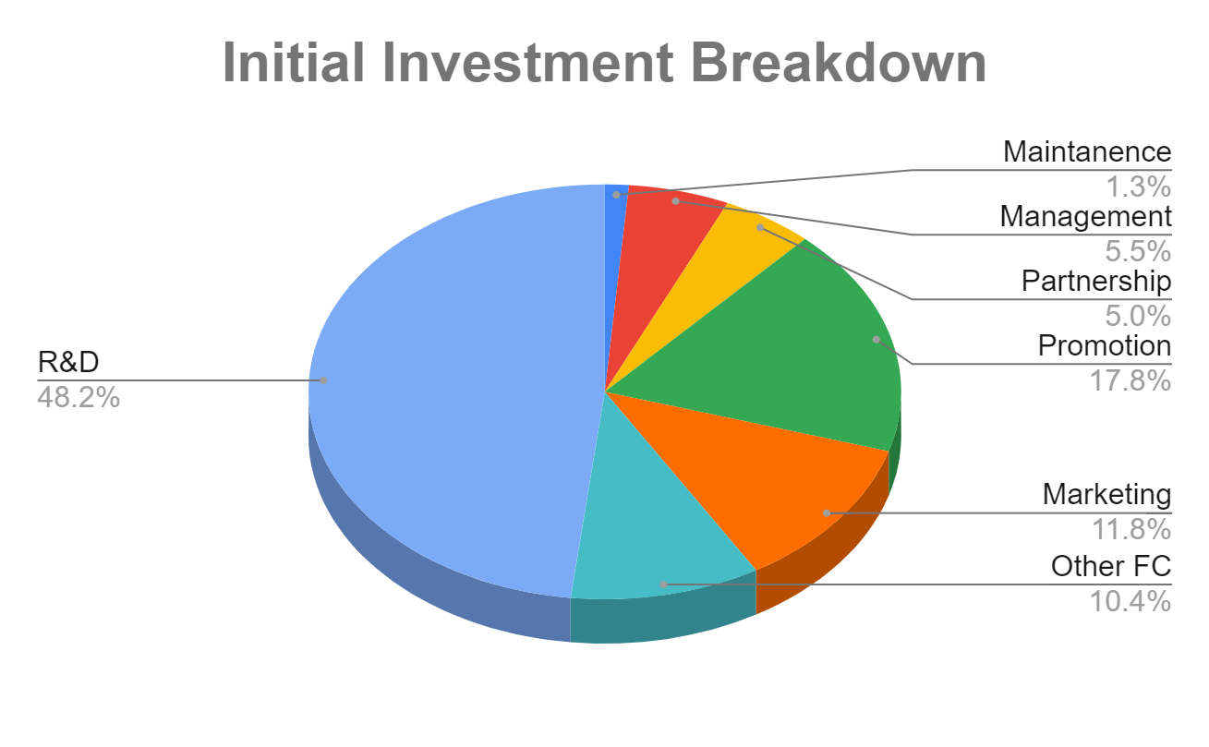
Use of Funds and Exit Strategies
Seeking initial investment of $500k for 35% equity
Primarily to offset year 1 costs
Exit Strategy:
Sell to big name craftsman companies such as Michaels
Sell technology to 3D printing companies that focus on industrial grade printers
Merge with medical companies for easy and accurate modeling

Slide 13
Summary
ME 3D allows for general public to experience 3D printing technology without the background typically required
Caters to those who are both familiar and unfamiliar with 3D printing
Our technology is able to reach a larger audience than other companies and we have an expanding team of members dedicated to our mission
“25% CAGR over 2018-2020” → as technology advances 3D printers will become cheaper and more commonplace, investing in ME 3D now will ensure you are ahead of the pack
Notes:
Compound annual growth rate

Slide 14
Backup Slides
Key Assumptions
 | Year 1 | Year 2 | Year 3
Total Number of Units Sold | 1300 | 7245 | 9578
Avg Selling Price per Unit | $ 700.00 | $ 700.00 | $ 700.00
Total Number of Subscriptions | 0 | 450 | 1,532
Avg Subscription Fee | $0.00 | $25.00 | $25.00
Total Revenue | $ 990,000.00 | $ 6,655,500.00 | $ 8,658,500.00
Partnership Cost per User | $ 22,100.00 | $ 174,555.00 | $ 366,585.00
Maintenance | $ 13,200.00 | $ 14,400.00 | $ 16,800.00
G/A | $ 1,800.00 | $ 1,920.00 | $ 2,160.00
Management | $ 55,680.00 | $ 79,872.00 | $ 99,840.00
R&D/Engineering | $ 198,000.00 | $ 180,000.00 | $ 378,000.00
Other FC (Rent, Utilities) | $ 105,000.00 | $ 105,000.00 | $ 105,000.00
Tax | 7% | 7% | 7%
Interest Rate | 6% | 6% | 6%
Employee Headcount | 7 | 9 | 13

Slide 15
BackUp Slides Cont. Monthly Assumptions Year 1
Year 1
Key Assumptions | Jan | Feb | Mar | Apr | May | Jun | Jul | Aug | Sep | Oct | Nov | Dec | Total Year
REVENUE
Total Cumulative Number of Units Sold | 0 | 0 | 50 | 100 | 0 | 0 | 300 | 500 | 700 | 900 | 1100 | 1300 | 1300
Number of Units Sold | 0 | 0 | 50 | 50 | 0 | 0 | 200 | 200 | 200 | 200 | 200 | 200 | 1300
Filament Subscription Users | $ - | $ - | $ - | $ - | $ - | $ - | $ - | $ - | $ - | $ - | $ - | $ - | $ -
Average Selling Price per Unit | $ 900.00 | $ 900.00 | $ (900.00) | $ (900.00) | $ 900.00 | $ 900.00 | $ 900.00 | $ 900.00 | $ 900.00 | $ 900.00 | $ 900.00 | $ 900.00 | $ 600.00
Total Revenue | $ - | $ - | $ (45,000.00) | $ (45,000.00) | $ - | $ - | $ 180,000.00 | $ 180,000.00 | $ 180,000.00 | $ 180,000.00 | $ 180,000.00 | $ 180,000.00 | $ 990,000.00
COSTS
Maintenance | $ 1,100.00 | $ 1,100.00 | $ 1,100.00 | $ 1,100.00 | $ 1,100.00 | $ 1,100.00 | $ 1,100.00 | $ 1,100.00 | $ 1,100.00 | $ 1,100.00 | $ 1,100.00 | $ 1,100.00 | $ 13,200.00
Partnership Costs | $ - | $ - | $ 850.00 | $ 850.00 | $ - | $ - | $ 3,400.00 | $ 3,400.00 | $ 3,400.00 | $ 3,400.00 | $ 3,400.00 | $ 3,400.00 | $ 22,100.00
Marketing | $ 6,500.00 | $ 6,500.00 | $ 6,500.00 | $ 6,500.00 | $ 6,500.00 | $ 7,500.00 | $ 4,500.00 | $ 4,500.00 | $ 4,500.00 | $ 4,500.00 | $ 5,500.00 | $ 5,500.00 | $ 69,000.00
G/A | $ 150.00 | $ 150.00 | $ 150.00 | $ 150.00 | $ 150.00 | $ 150.00 | $ 150.00 | $ 150.00 | $ 150.00 | $ 150.00 | $ 150.00 | $ 150.00 | $ 1,800.00
Management | $ 4,640.00 | $ 4,640.00 | $ 4,640.00 | $ 4,640.00 | $ 4,640.00 | $ 4,640.00 | $ 4,640.00 | $ 4,640.00 | $ 4,640.00 | $ 4,640.00 | $ 4,640.00 | $ 4,640.00 | $ 55,680.00
R&D/Engineering | $ 99,000.00 | $ 9,000.00 | $ 9,000.00 | $ 9,000.00 | $ 9,000.00 | $ 9,000.00 | $ 9,000.00 | $ 9,000.00 | $ 9,000.00 | $ 9,000.00 | $ 9,000.00 | $ 9,000.00 | $ 198,000.00
Other FC (Rent, Utilities) | $ 8,750.00 | $ 8,750.00 | $ 8,750.00 | $ 8,750.00 | $ 8,750.00 | $ 8,750.00 | $ 8,750.00 | $ 8,750.00 | $ 8,750.00 | $ 8,750.00 | $ 8,750.00 | $ 8,750.00 | $ 105,000.00
Total Costs | $ 120,140.00 | $ 30,140.00 | $ 30,990.00 | $ 30,990.00 | $ 30,140.00 | $ 31,140.00 | $ 31,540.00 | $ 31,540.00 | $ 31,540.00 | $ 31,540.00 | $ 32,540.00 | $ 32,540.00 | $ 464,780.00
Tax | 7% | 7% | 7% | 7% | 7% | 7% | 7% | 7% | 7% | 7% | 7% | 7% | 7%
Interest Rate | 6% | 6% | 6% | 6% | 6% | 6% | 6% | 6% | 6% | 6% | 6% | 6% | 6%

Slide 16
BackUp Slides Cont. Notes Year 1
-Assume no units sold Jan-June, limited quantity launch date in July
-Free units distributed to tech promoters, reviewers in March and April
-Formlabs Kickstarter: Broke $100,000 target in 2.5 hours, hit $1,000,000 in 2.5 days
-Maintenance includes: updating app, server and website maintenance
-Marketing: Youtube = $10/day + other social media
-Aggressive marketing before launch, and during holiday season
-Kansas based company, management team starts off making state minimum wage ($7.25/hr)
-Assume 25,000 warehouse acquired at $0.35/day for rent and utilities
-Kansas 4% flat tax rate plus 3% surtax on income over $50,000
-Each printer comes with 1kg of ABS Filament which usually costs $17/kg since we are selling a limited quantity we can buy exact number of filament for the first year
-Filament refill subscription service not in effect first year
-team of 3 R&D/Engineering paid at $3000 per month
- each printer costs $400 to manufacture
-assume app takes 60k to develop (goes into R&D), rule of thumb: about 20% of developing cost is spent on maintenance per year
Assume it costs $30,000 to obtain everything necessary to manufacture our product, goes into R&D

Slide 17
Backup Slides Cont. Notes for Year 2 & 3
Notes
-raised hourly rate of management to $10.40/hour
-added another 2 people to R&D/Engineering for consulting purposes $3000 per person per month
-partnership cost (number of units sold+total subscription users)*$15/kg b/c buy in bulk now
Notes
-raised hourly rate of management to $13/hour
-added another 4 people to R&D/Engineering team $3500 per person per month

Slide 18
Backup Slides Cont. Expansion
subscription of different kinds of filament
Subscription for different colors of filament
Exclusive CAD models with subscription
Forum in app for users to post their own CAD models that get verified by experts
Why start with ABS?
“ABS (Acrylonitrile Butadiene Styrene) is another commonly used 3D printer material. Best used for making durable parts that need to withstand higher temperatures. In comparison to PLA filament, ABS plastic is less ‘brittle’ and more ‘ductile.’”
Notes:
https://www.matterhackers.com/3d-printer-filament-compare

